Slide 1
CMU Hackathon Power System Dynamics
Steve Abate, Gian Alian
September 2020

Slide 2



DLC Hackathon Team
Steve Abate
Transmission Planning Engineer
Gian Alian
Transmission Planning Engineer
Elizabeth Cook
Senior Manager of Transmission and Distribution Planning
Hackathon Mentor
Hackathon Mentor
Hackathon Judge

Slide 3
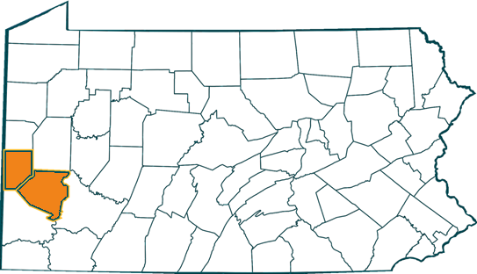
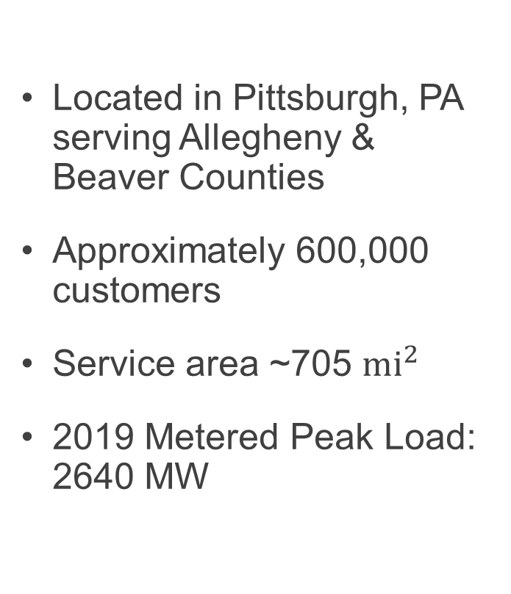
DLC Company Profile
Located in Pittsburgh, PA serving Allegheny & Beaver Counties
Approximately 600,000 customers
Service area ~705 $mi^{2}$
2019 Metered Peak Load: 2640 MW

Slide 4
Presentation Overview
DLC Transmission Planning
Power System Dynamics
Hackathon Challenges
Description of Dataset
Output Requirements

Slide 5
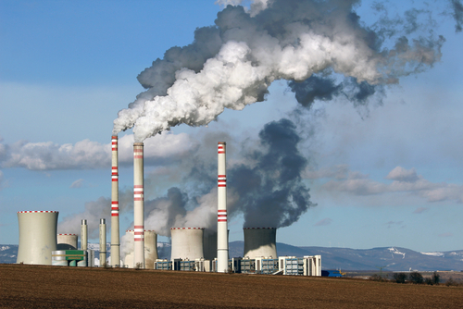


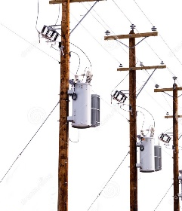

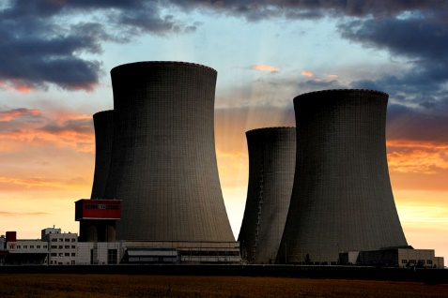


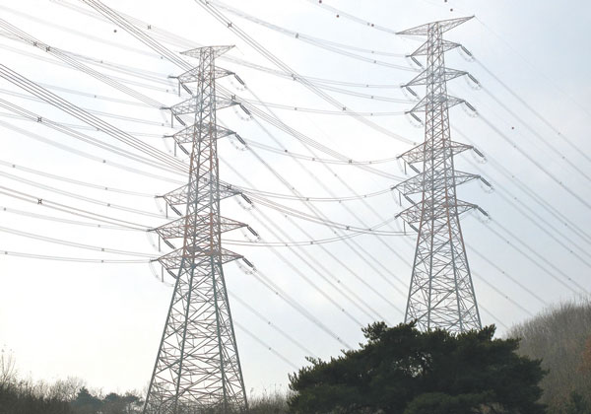

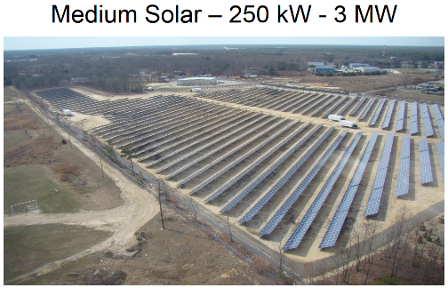
Transmission Planning Assessment Overview
Generators
Transmission Network
Loads

Slide 6
Transmission Planning Assessment Overview
Although there are different types of studies, the goal of all transmission studies is to identify whether or not system limits are exceeded during normal and contingency conditions.
Steady-state analysis
Short-circuit analysis
Stability analysis
Generator #3
100 MW
Generator #1
100 MW
Generator #2
100 MW
Load
300 MW

Slide 7
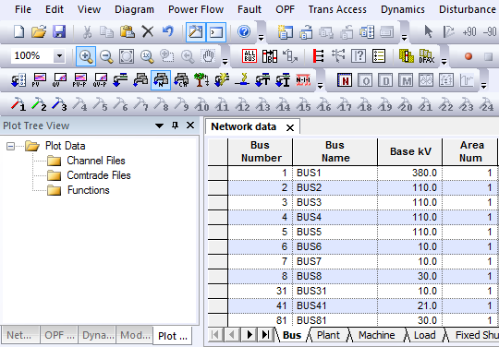
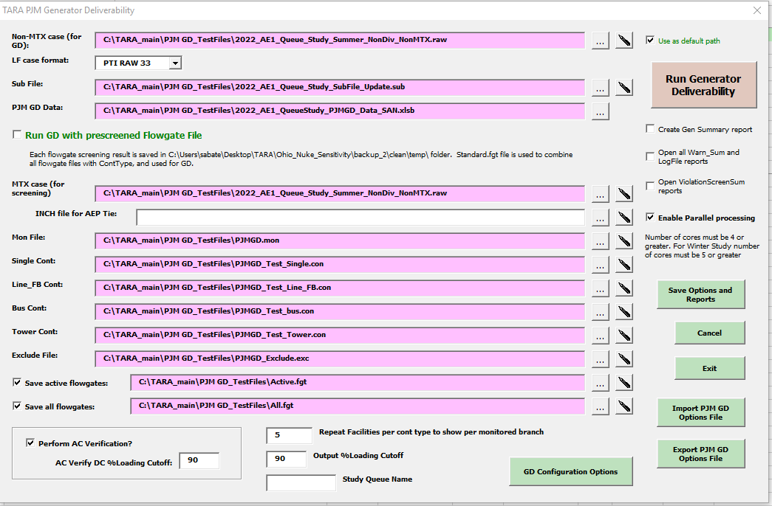
Transmission Planning Assessment Overview
Although there are different types of studies, the goal of all transmission studies is to identify whether or not system limits are exceeded during normal and contingency conditions.
Steady-state Analysis Example:
Can the system operate within limits after losing Transmission Line A?
Contingency:
Loss of Line A
Generator #3
100 MW
Generator #1
100 MW
X
Load Bus
0.941 per-unit voltage
Generator #2
100 MW
Line B
105% of rating
Load
300 MW

Slide 8
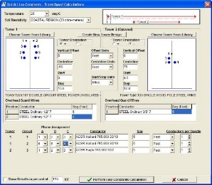
Transmission Planning Assessment Overview
Although there are different types of studies, the goal of all transmission studies is to identify whether or not system limits are exceeded during normal and contingency conditions.
Short-circuit Example:
Can the system clear a fault on Transmission Line A?
50 kA
Generator #3
100 MW
Generator #1
100 MW
Fault on Line A
59 kA fault current exceeds breaker interrupting capacity
59 kA
30 kA
Generator #2
100 MW
Load
300 MW

Slide 9
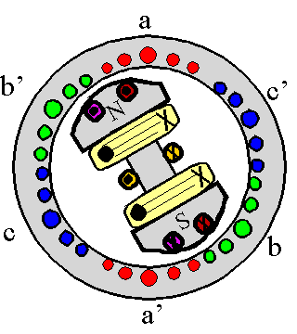

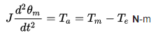
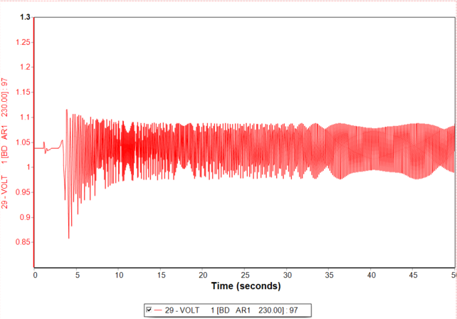
Transmission Planning Assessment Overview
Although there are different types of studies, the goal of all transmission studies is to identify whether or not system limits are exceeded during normal and contingency conditions.
Stability Example:
Can the system stabilize after the protection system clears a fault?
Generator #3
100 MW
Generator #1
100 MW
Fault on Line A
Line A cleared in
~8 cycles
Model Generator dynamics
Voltage response:
Unstable
Generator #2
100 MW
Load
300 MW

Slide 10
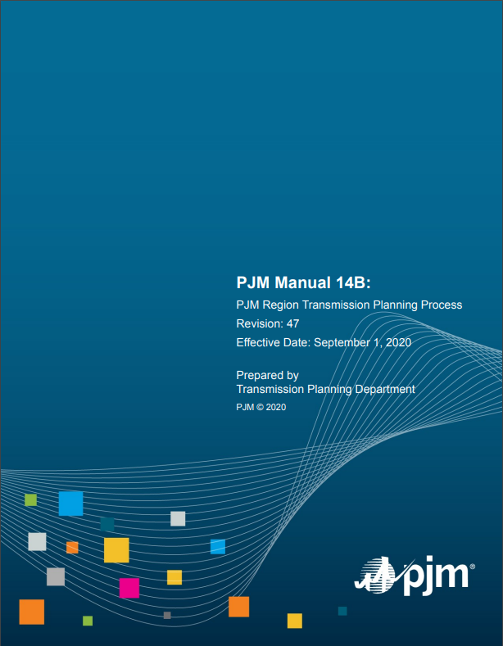
Transmission Planning Assessment Overview
Transmission System Analysis
NERC Planning Criteria Compliance
Load and Generator Deliverability
N-1-1 Analysis
Short Circuit
Stability
Light Load
Winter Peak
Generation Deactivation
More information on RTEP analysis can be found in PJM Manual 14B

Slide 11
Power System Stability
What is power system stability?
“Power system stability may be broadly defined as the property of a power system that enables it to remain in a state of operating equilibrium under normal conditions and to regain an acceptable state of equilibrium after being subjected to a disturbance”
Disturbances:
Transmission System Faults
Sudden Large Load Changes
Loss of Generating Units
Line Switching
Etc.

Slide 12
Power System Dynamic Model
Generators
Transmission Network
Loads

Slide 13
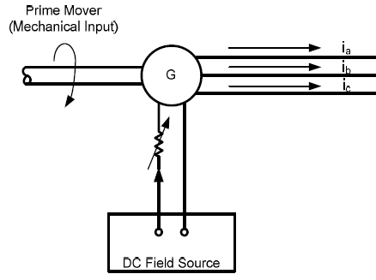
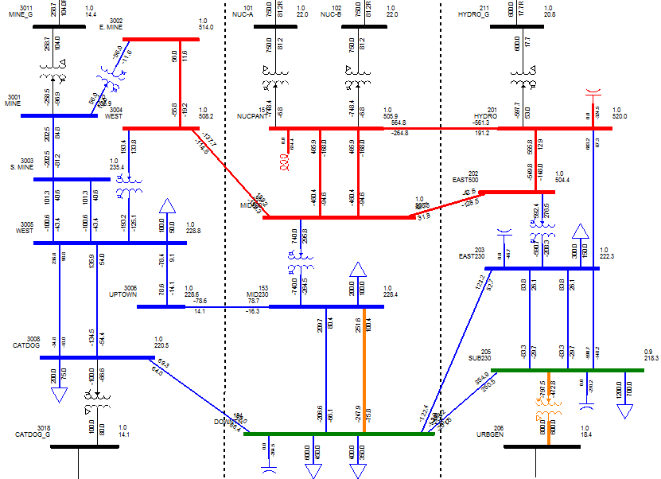
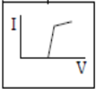
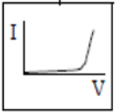
Power System Dynamic Model
Overview
Generators
Transmission Network
Loads
1
1
2
m
n
Load Dynamics
Large Motor
Generator Dynamics
Small Motor
Discharge Lighting
Transformer Saturation

Slide 14
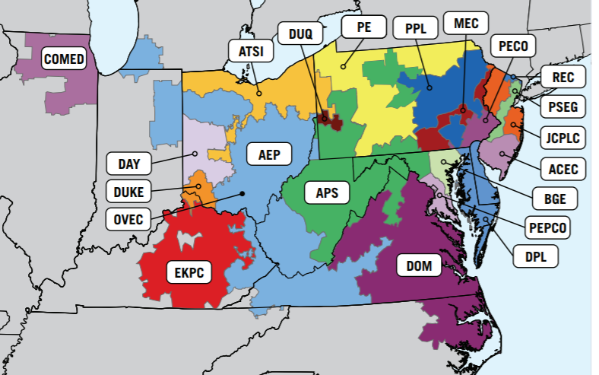
Power System Dynamic Model
PJM MMWG Model
Network Data
~80,000 buses
~74,000 transmission lines
~21,000 transformers
~9,000 generators
Dynamic Data
Machine Models
(25+ parameters each)
Exciter
Governor
Stabilizer
Wind Generator Models (15+ parameters each)
Load Models (~8 parameters each, but some have 130+ parameters each)
Hundreds of contingencies for DLC assessment

Slide 15
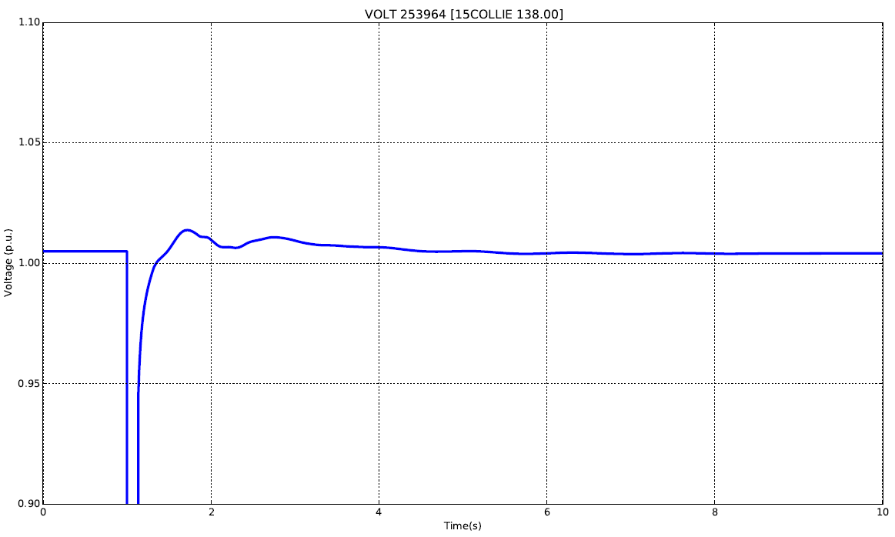
Simulation Results
System response to minor disturbance
(138 kV transmission line fault with normal clearing)
Voltage at DLC 138 kV bus after nearby 138 kV fault
Disturbance
At t=1 sec

Slide 16
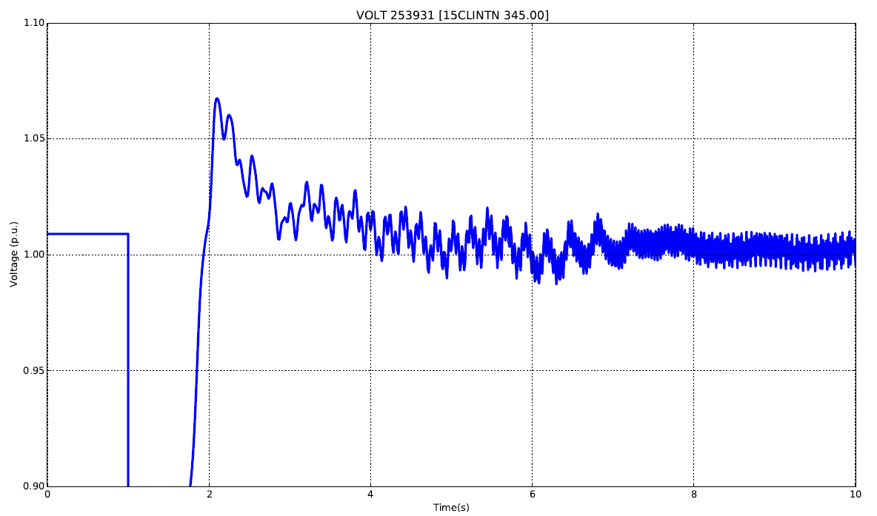
Simulation Results
System response to larger disturbance
(500 kV transmission line fault with delayed clearing)
Voltage at DLC 345 kV bus after
500 kV fault in other territory
Disturbance
At t=1 sec

Slide 17
Hackathon Problem Statement
Problem – Current simulation data processing relies on manual methods to identify key parameters. Given the large amount of data produced by dynamic simulations, this can be time consuming.
Challenge – Develop a scripted method to perform a set of tasks on each simulation results file.

Slide 18
Hackathon Challenge
Hackathon Challenge – Create a scripted method to perform the following tasks on power system dynamic simulation data.
Task #1 – Create graphic plot of power system variables
Generator Terminal Voltage (ETRM), Generator Power (POWR), Generator Speed (SPD), Bus Voltages (VOLT)
Task #2 – Identify the time at which the disturbance occurs
Power system variables will begin to fluctuate at the time of the disturbance
Task #3 – Identify whether or not the system remains stable
The system is stable if all power system quantities in Task #1 reach a steady-state (constant) value after the power system event.
Task #4 – Do all voltages restore in accordance with PJM criteria?
Calculate the recovery time for each bus voltage.
Task #5 – Does the system stabilize with sufficient damping per PJM criteria?
Calculate the damping of the Generator Speed (SPD) for each generator
Refer to the provided document “PSSE Documentation – Modal Analysis.pdf” for more information.

Slide 19
Task #1: Create a graphic plot of power system variables – the plot should include axis labels, title, and legend

Slide 20
Task #2: Identify the time at which the disturbance occurs – Power system disturbance will cause a large drop in voltage
Time at which disturbance occurs

Slide 21
Task #3: Identify whether or not the system remains stable – Some power system disturbances cause machine variables (voltage, power, and speed) to go unstable
Stable System
Unstable System
Note: Speed can appear non-oscillatory for an unstable case. However, notice how they lose synchronism and deviate from each other.

Slide 22
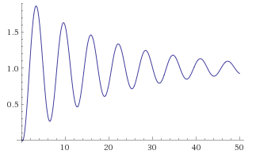
Task #4 & #5
PJM criteria for acceptable stability
(per PJM Manual 14B):
Recover to minimum of 0.7 p.u. after 2.5 seconds
Damping exceeds 3%

Slide 23
Task #4 & #5
PJM criteria for acceptable stability
(per PJM Manual 14B):
Recover to minimum of 0.7 p.u. after 2.5 seconds
Damping exceeds 3%
0.7 p.u.
“When a fault occurs on the transmission system, system voltages are temporarily reduced. Once the fault is cleared, voltages follow transient voltage recovery trajectories governed by system dynamics. […] the voltage following fault clearing shall recover to a minimum of 0.7 p.u. after 2.5 seconds.”
Recovery time:
How fast voltage recovers to 0.7 p.u.
2.5 sec

Slide 24
Task #4: Calculate the recovery time for each bus voltage
Amount of time it takes for the machine voltage to recover to 0.7 p.u.

Slide 25
Task #5
PJM criteria for acceptable stability
(per PJM Manual 14B):
Recover to minimum of 0.7 p.u. after 2.5 seconds
Damping exceeds 3%
Damping: How fast
the system stabilizes
“A sustained oscillatory system response, even if slightly damped, will cause the system to be in a vulnerable state and exposed to adverse impacts for subsequent changes to the system over some prolonged time.”

Slide 26
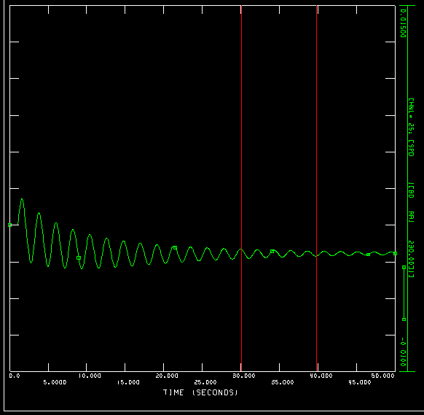
Task #5 – Modal Analysis
Modal Analysis
Goal of modal analysis is to represent the signal as a sum of decaying exponential sinusoids.
For the transient period (~5-10 seconds after event), non-linear characteristics can be dominant.
Normally, modal analysis is performed 10-15 seconds after the event (we recommend using 30-40 seconds for these events)
Experiment with the selected window and compare the results.
Refer to the attachment “PSSE Documentation - Modal Analysis.pdf” for more information

Slide 27
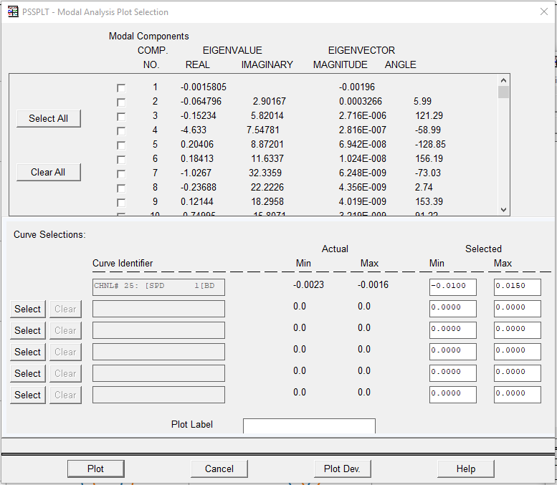
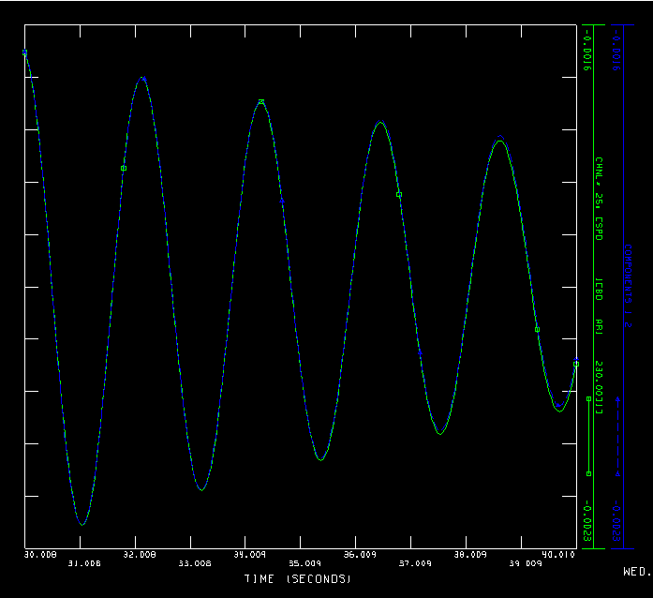
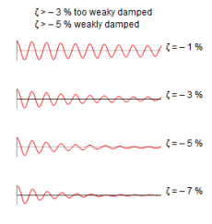
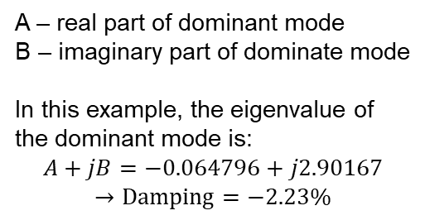
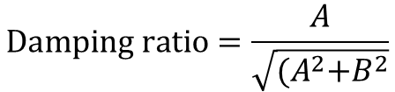
Task #5 – Modal Analysis
$$Damping ratio=\frac{A}{\sqrt{{(A}^{2}+B^{2}}}$$
A – real part of dominant mode
B – imaginary part of dominate mode
In this example, the eigenvalue of the dominant mode is:
$$A+jB=−0.064796+j2.90167$$
$$→Damping=−2.23\%$$

Slide 28
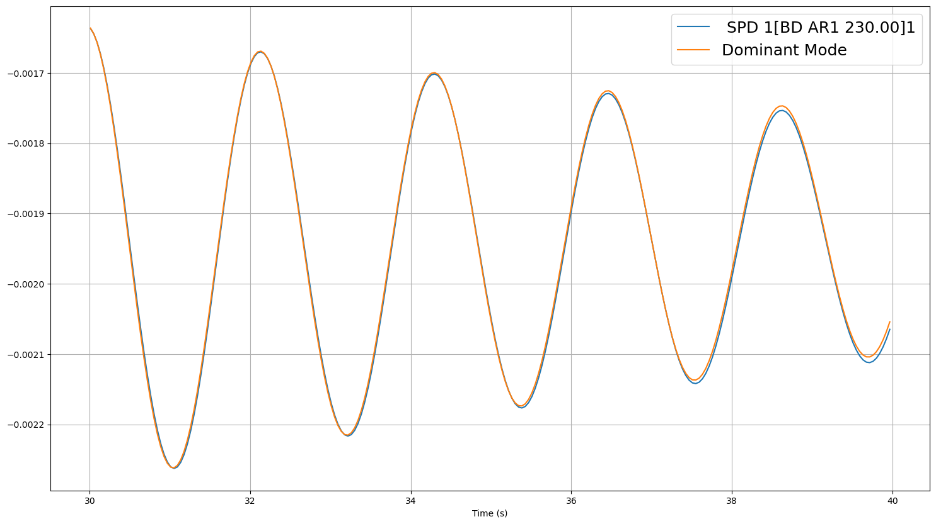
Task #5 – Modal Analysis

Slide 29
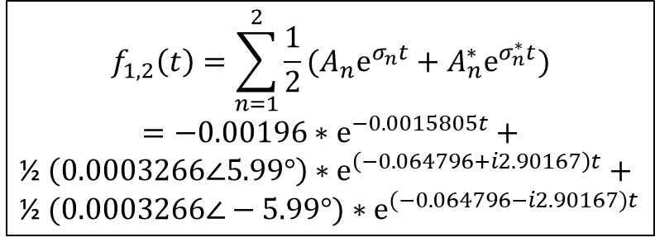
Task #5 – Modal Analysis
Once modal analysis is performed, the dominant mode can be used to approximate the signal.
$$f_{1,2}\left(t\right)=\sum_{n=1}^{2}{\frac{1}{2}(A_{n}e^{σ_{n}t}+A_{n}^{∗}e^{σ_{n}^{∗}t})}$$
$$=−0.00196∗e^{−0.0015805t}+$$
½ $\left(0.0003266∠5.99°\right)∗e^{\left(−0.064796+i2.90167\right)t}+$
½ $(0.0003266∠−5.99°)∗e^{(−0.064796−i2.90167)t}$

Slide 30
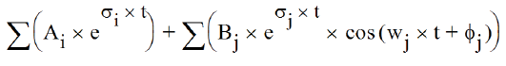
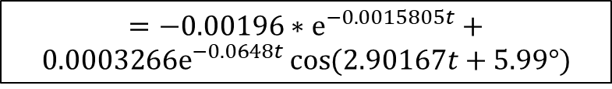
Task #5 – Modal Analysis
Note: The dominant mode can be also expressed in a cosine form.
$$=−0.00196∗e^{−0.0015805t}+$$
$${0.0003266e}^{−0.0648t}\cos{(2.90167t+5.99°)}$$

Slide 31
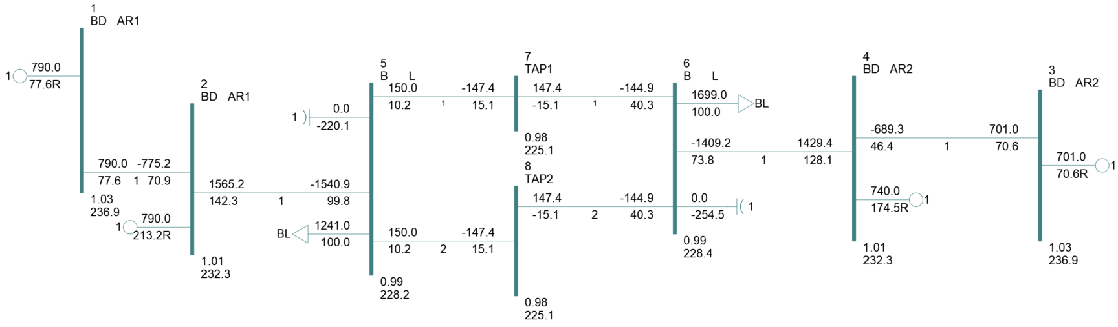
Description of Dataset
The challenge dataset is based on a simple eight (8) bus test system:
Four (4) generators
Two (2) shunt capacitors
Two (2) loads
The dataset consists of dynamic simulation results for 369 different events.

Slide 32
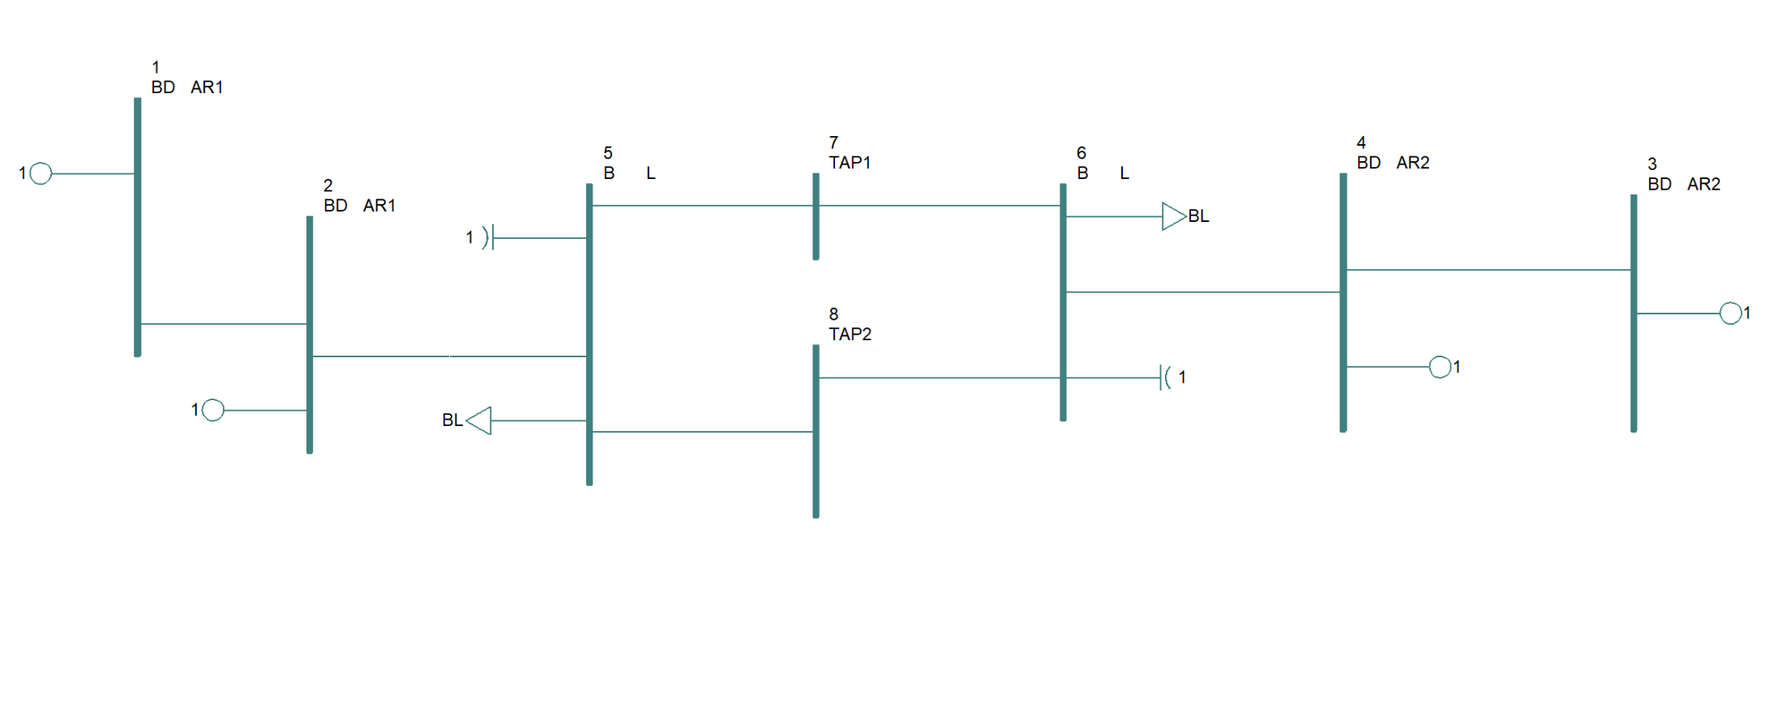
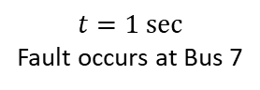
Description of Dataset
Example: Simulation # 96
$$t=1 sec$$
Fault occurs at Bus 7

Slide 33
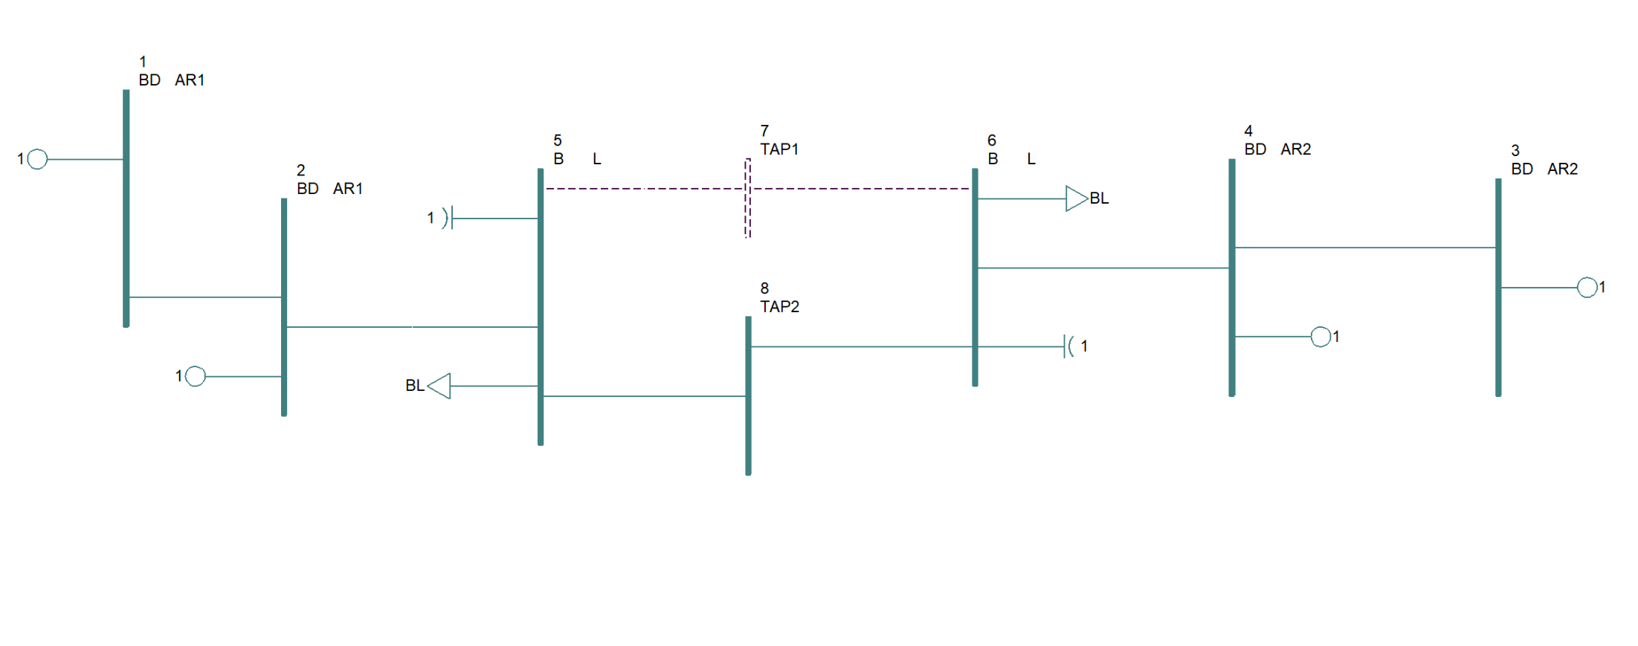
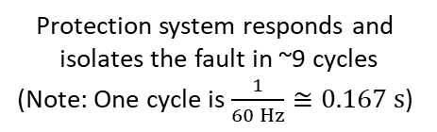
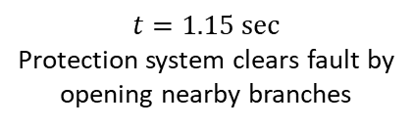
Description of Dataset
Example: Simulation # 96
$$t=1.15 sec$$
Protection system clears fault by
opening nearby branches
Protection system responds and
isolates the fault in ~9 cycles
(Note: One cycle is $\frac{1}{60 Hz}≅0.167 s$)

Slide 34
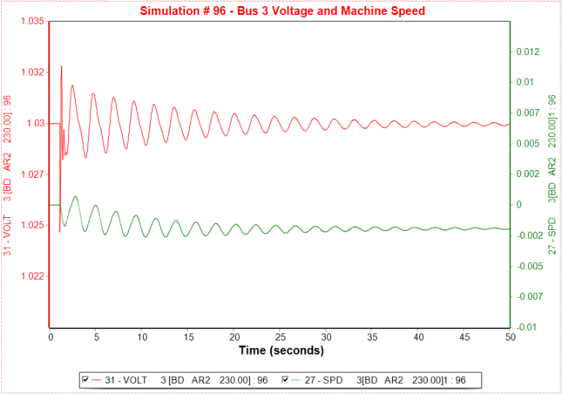
Description of Dataset
Example: Simulation # 96

Slide 35
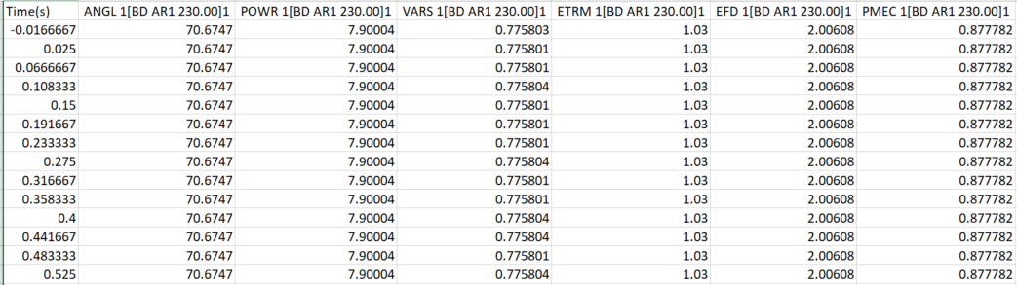
Description of Dataset
The Hackathon dataset includes time-series power system quantities for each simulation (369 total)
Comma-separate file
for each simulation:
Columns for each power system variable
0.csv
1.csv
2.csv
…
366.csv
367.csv
368.csv
369.csv

Slide 36
Output Requirements
For each simulation, the following information should be reported:
Simulation number
Plot of Power System Variables – Task #1
Disturbance Time (s) – Task #2
Stable (Yes / No) – Task #3
Recovery Time (s) – Task #4
Modal Analysis Results – Task #5
Although the 30-40 sec window is recommended for this challenge, please investigate how the window selection will impact modal analysis results as the proper window is not always known.

